Slide 1
OSINT
PRESENTATION

Slide 2
Agenda
Introduction – What is OSINT?
Application – How do red teamers use it?
Application – How to blue teamers defend?

Slide 3
What is Open source Intel (OSINT)?
The process of gathering and analyzing publicly available information to assess threats, make decisions, or answer specific questions.
Common ways you use OSINT currently:
Online research
Should I purchase this?
"is this company legit?"
Notes:
https://www.ibm.com/think/topics/osint

Slide 4
Quick History lesson:
1941 – Establishment of the Foreign Broadcast Monitoring Service (FBMS)
July 2004 – Commission recommended open source intelligence agency
Open Source center created to collect information, absorbed FBMS

Slide 5
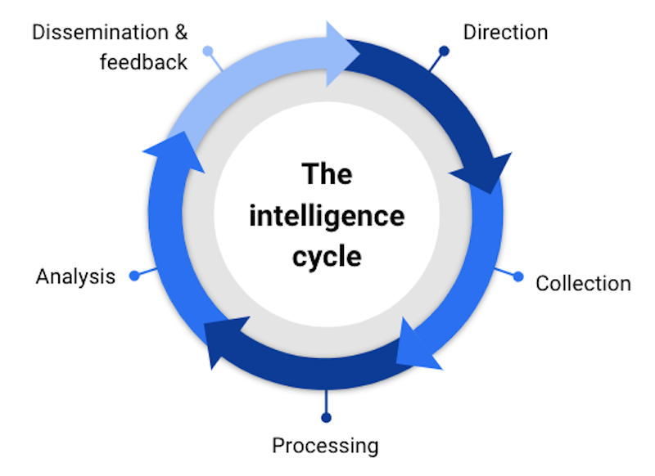
The Intelligence Cycle

Slide 6
Categories of OSINT
Category Name | Description
Media | Newspapers, magazines, radio, television
Internet | Online publications, blogs, discussion groups, social media
Publicly Available Government Data | Public government reports
Professional and academic publications | Information acquired from journals
Commercial Data | Commercial imagery, financial and industrial assessments and databases
Grey Literature | Technical reports, preprints, patents, working papers, business documents, unpublished works and newsletters
As broad as the definition is, we need to narrow it down

Slide 7
How do you approach open source intel?
Objective, what type of information are you trying to find?
Tools: What would make this search faster?
Sources: Where are you looking to obtain this information? (Start small and work larger.)
Remember the intel cycle:
Prepare -> Collect -> Process -> Analysis -> Disseminate

Slide 8

Information Explosion
The hardest part of OSINT to deal with
Large volume of information that has happened in the many years of the internet

Slide 9
Regarding the
Offense

Slide 10
Lets start with a fun demonstration
Search this on google:
not for public release filetype:pdf
Or maybe:
”index of” inurl:ftp secret
Act of "Google Dorking"

Slide 11
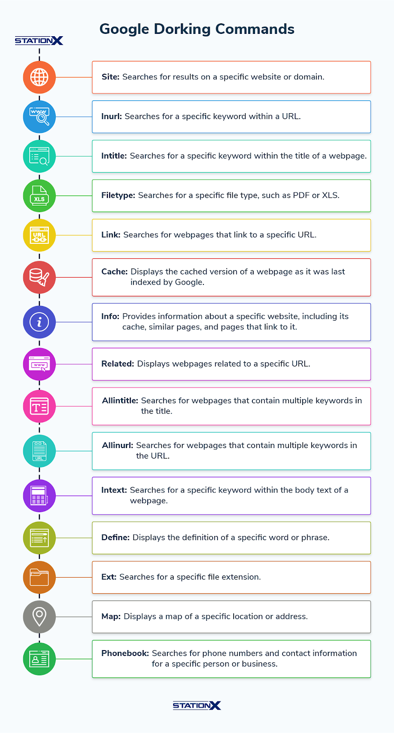
"Search Hacking"
Google Dorking

Slide 12
What other kinds of information can OSINT FIND?
Name | Details
Social Media information | Entrance badges, office photos,
Social engineering enablement | Blackmail information, Heirarchy mapping
Attack surface | Supply chain partners, Subsidiaries
Tech stack | What software are they using?
Domain enumeration | Any weird admin pages?
Github secrets | API keys / software stacks

Slide 13
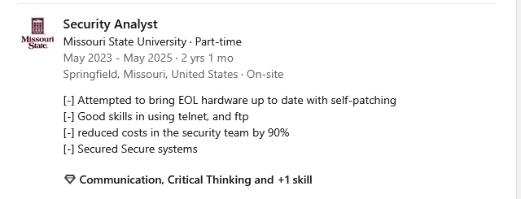
What does this tell you about the company?
Eol hardware
Unsecured Protocols
Defunded security team
Is this useful to an attacker?
Notes:
Image should be shown here that will have a social media profile for a software engineer for a company with listed skills in specific areas for that company

Slide 14
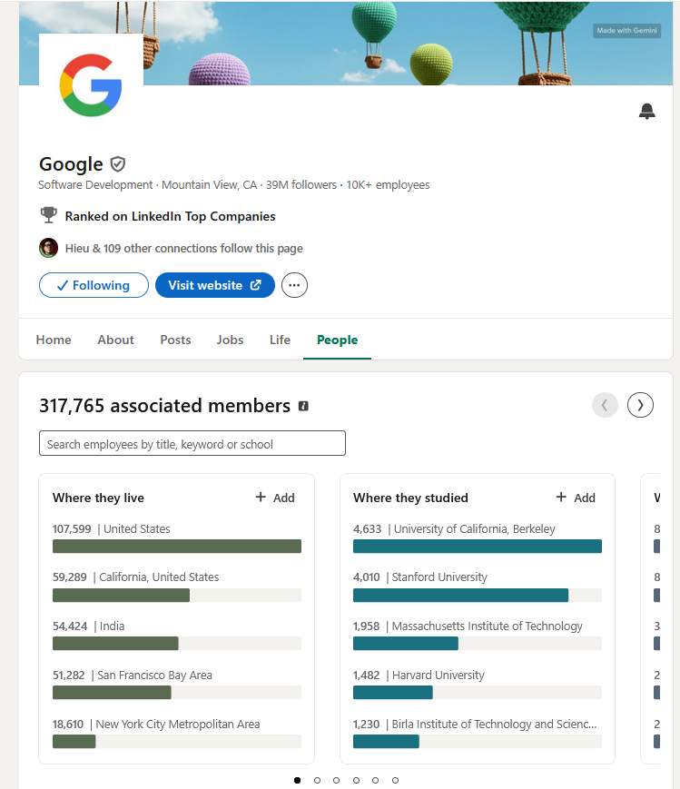

Hackers using OSINT
"Who works at the company?"
"What software does the company use?"
Did an employee reveal confidential information online?

Slide 15

Website demonstration:
Whatsmyname.web

Slide 16
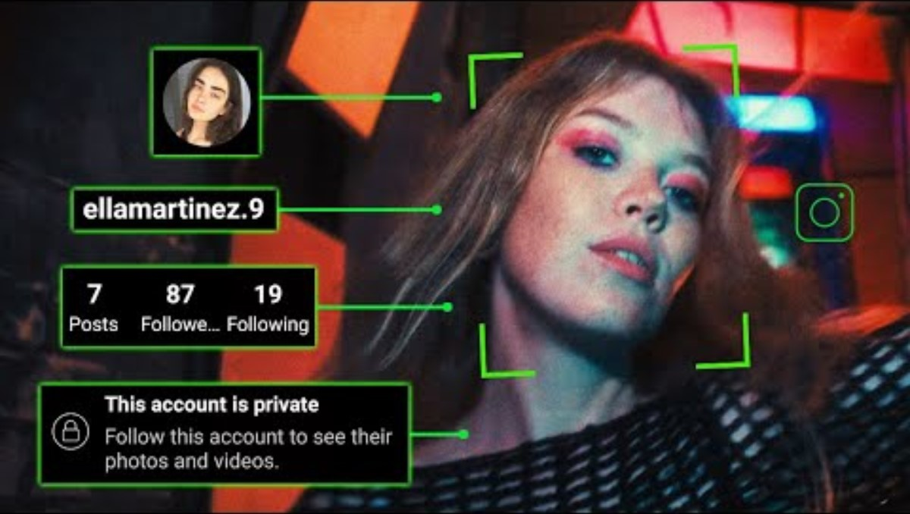
Case Study: Osint on the offense

Slide 17
Regarding the
Defense

Slide 18
How would you defend against osint?

Slide 19
OSINT Defense
Education:
Cybersecurity training
Non Disclosure Agreement
Social Media Policy
Encouraging of sensitive members to have private profiles
Active testing:
Penetration tests (OSINT)
Social media monitoring tools
Routine audits of social media accounts

Slide 20

How do defenders use osint?
Indicator of Compromise Hunting
Campaign tracking and pattern analysis
Malware family research (virustotal.com)
Industry threat trends

Slide 21
Virus total Demo
Hash:
0e0d4494780c9010ece88f39f65bfbfcb13236e1652f7fe41e9c84a5b16583a5

Slide 22
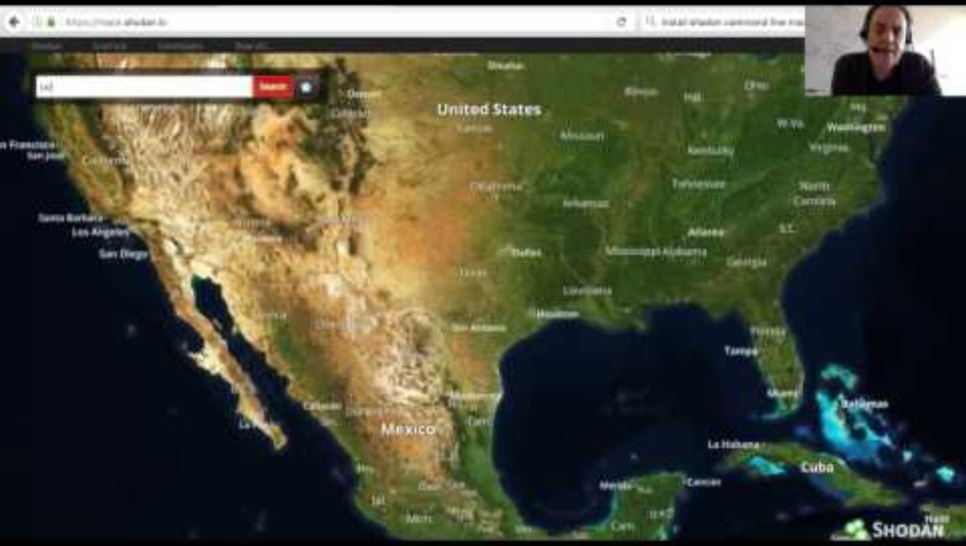
Shodan Demonstration
Tool to map out the internet
Used mainly to assess impact of CVE's

Slide 23
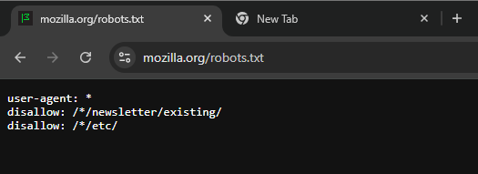
Robots.txt
A way to prevent pages from being "crawled"
Blocks robots (including ai) from crawling websites specified

Slide 24
OSINT Tools
https://whatsmyname.app/
https://archive.org/
https://keyserver.ubuntu.com/
WEB
Urlscan.io/

Slide 25
Capture the flag methodology
Fake social media accounts to locate and investigate
Lets go through a CTF room together:
https://tryhackme.com/room/sakura

Slide 26
THANK YOU
Tyler Olson
816-591-6175
To329s@missouristate.edu

